Slide 1
QNB – Excel++ Tool – Demo
October 23, 2017

Slide 2
Agenda
IFRS 9 ECL Requirements Recap
QNB Methodology and TIN Decisions
Excel++ Tool Configuration
QNB – June 2017 – Tool Output
Tool Demo
Run / Control Buttons
Illustrative ECL calculations and sensitivities

Slide 3
IFRS 9 ECL Requirements Recap A host of complexities but essentially a very simple formula
Outstanding
Committed
CCF
1, 2 or 3
Auto v Individual
Backwards transition
ECL
=
EAD
PD
Stage
LGD
df
Rating / DPD
12mths
Lifetime
Collateral
Haircut
LGD

Slide 4
QNB Methodology and TIN Decisions EAD is relatively straight forward but PD requires application of models
EAD
Insert text – drawn, undrawn, off balance sheet, CCF and amortisation
PD
Insert text - TTC, CCI, PiT, Scenarios, Geographic

Slide 5
QNB Methodology and TIN Decisions Due to a lack of historic loss data a simplified approach to LGD has been taken
LGD
Insert text – collateral, haircuts, 10% floor, Basel 45% + 5%
Discount Factor
Insert text – use of contractual

Slide 6
QNB Methodology and TIN Decisions Staging rules (mostly automated) has been agreed with Credit Department
Staging
Insert text – rules plus individual assessment
ECL Methodology
Insert text – summarize from methodology

Slide 7
Excel++ Tool Configuration Multiple calculations based on customer data and model assumptions
Input Data
ECL Components
Reporting
Customer level data
PD Curves
LGD
Macro
Factors
Stress Scenarios
IFRS 9 Provisions
Facility/deal level data
Management Reporting
EXCEL ++ Tool
ECL CALCULATOR
Collateral
Impairment Calculation
Regulatory reporting
Customer Risk Rating
Financial Statements & Analysis
Staging Decisions
This needs formatting

Slide 8
Excel++ Tool Configuration The primary input for each run is the ETL of customer data on the reporting date
Inputs
Data Extraction
ECL Calculation
Core Systems
Outputs
OPICS
Extract, Transform, Load (ETL)
Output from ETL
(Retail & Non-Retail)
ECL
Tool
Equation
Default Data
Ratings Data
Data
Warehouse
Collateral Data
Recovery Data
Output Data
TIS
Guarantee Data
Customer Demographics
PRIME
Facility / Portfolio Details
This needs formatting
ETL PROCESS
Rules and assumptions are applied for data completeness and accuracy
(Extract) System data is imported from data warehouse per schedule
ETL data is reconciled to GL
(Transform) ETL processes data and prepares output files
Status report is generated, exceptions detailed
(Load) Output files are placed in ECL folder
Data is checked for quality

Slide 9
QNB – June 2017 – Tool Output Need story line on each page

Slide 10
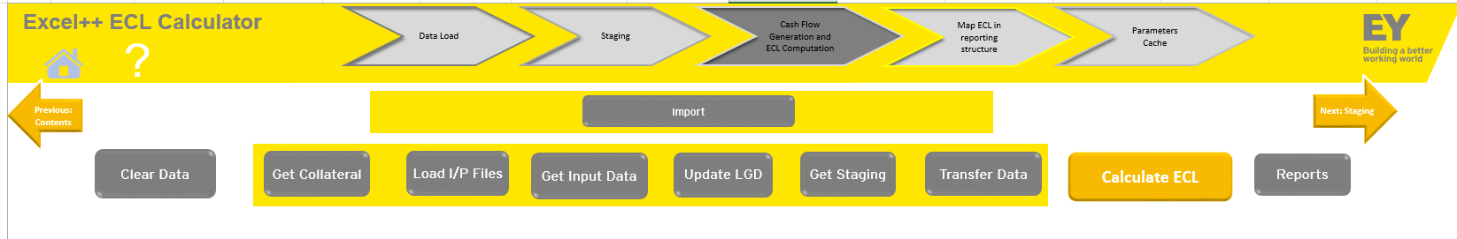
Tool Demo Run Control buttons
Clear Data : Erases all the data from the previous run if any .
Get Collateral : It transfers the collateral relevant data from the raw dataset to the tool.
Load I/P Files : Transfers all necessary data from raw file to an intermediate file so that tool can easily access the required data when needed.
Get Input Data : Populates the relevant data in the ‘Data Input’ Tab.
Update LGD : LGD gets updated in the ‘Data Input’ Tab.
Get Staging : Staging calculation happens and final stage gets populated in ‘Data Input’ Tab.
Transfer Data : It is to move all the data required for ECL calculation to the segregated ECL calculation tool which automatically gets opened with all the data being populated.
Calculate ECL : This button on the segregated tool does all the cash flows and final ECL numbers are populated on the ‘Data Input’ Tab when finished.
Reports : Under development phase.

Slide 11
Tool Demo The ECL from variety of exposures will be illustrated, along with sensitivities
Staging
Stage 1 – 12mth ECL – 32,043
Stage 2 – lifetime ECL – 88,867
Stage 3 – no ECL (existing QCB rules applied)
xxxx
ssss
ssss

Slide 12
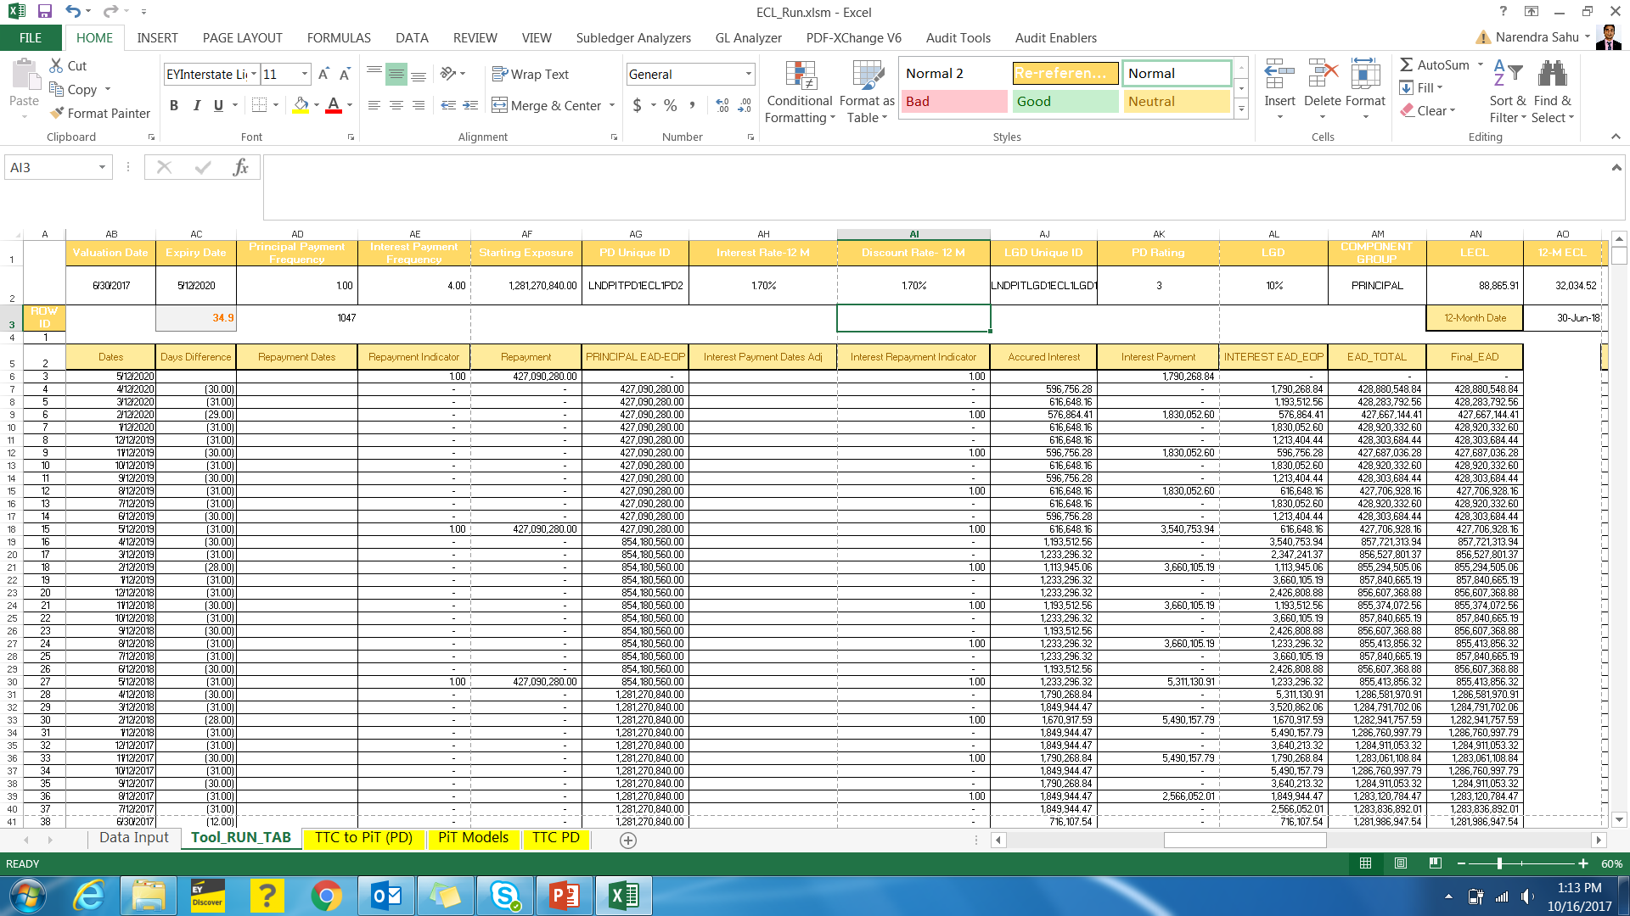

Slide 13
Repayments:
Bullet : LECL- 156,387 / 12M ECL- 34,041
Amortizing : LECL- 65,862 / 12M ECL- 27,778

Slide 14
PD
PD ( for Rating of 12 is 1.3%): 12M ECL- 2,381
(for Rating of 13 is 2.02%): 12M ECL- 3,709

Slide 15
Interest Rate
At 0% EIR : LECL- 1,534,183 / 12MECL- 766,380
At 10% EIR: LECL- 1,449,177 / 12MECL- 752,149

Slide 16
Blank Need story line on each page
• Demo for 23rd Oct – we need 3 parts i) a PPT to explain the features; ii) the 30Jun17 output for Non-Retail iii) a live demo with one or two trades….to show the impact of changes to:-
o Stages 1, 2 and 3
o Repayment – bullet or amortizing
o TTC PDs and CCIs
o Collateral – secured, unsecured and 10% floor
o Interest and EIR
o Off balance sheet commitments – 1 year and beyond
o Anything else you can think of
o ** - We need to develop the story line and run it ourselves first
o ** - Receipt of our $0.5m fee depends on this, so there is no room for a f#ck up…!!

Slide 17
Ernst & Young LLP
EY | Assurance | Tax | Transactions | Advisory
About EY
EY is a global leader in assurance, tax, transaction and advisory services. The insights and quality services we deliver help build trust and confidence in the capital markets and in economies the world over. We develop outstanding leaders who team to deliver on our promises to all of our stakeholders. In so doing, we play a critical role in building a better working world for our people, for our clients and for our communities.
EY refers to the global organization, and may refer to one or more, of the member firms of Ernst & Young Global Limited, each of which is a separate legal entity. Ernst & Young Global Limited, a UK company limited by guarantee, does not provide services to clients. For more information about our organization, please visit ey.com.
Ernst & Young LLP is one of the Indian client serving member firms of EYGM Limited. For more information about our organization, please visit www.ey.com/in.
Ernst & Young LLP is a Limited Liability Partnership, registered under the Limited Liability Partnership Act, 2008 in India, having its registered office at 22 Camac Street, 3rd Floor, Block C, Kolkata – 700016
© 2017 Ernst & Young LLP. Published in India. All Rights Reserved.
This publication contains information in summary form and is therefore intended for general guidance only. It is not intended to be a substitute for detailed research or the exercise of professional judgment. Neither EYGM Limited nor any other member of the global Ernst & Young organization can accept any responsibility for loss occasioned to any person acting or refraining from action as a result of any material in this publication. On any specific matter, reference should be made to the appropriate advisor.

